Slide 1
ASTRONOMY FORUM WEBSITE (BITSPACE)
Team members:
SANJANA MISHRA (18BCE2324)
ANURAG PARCHA (18BCE2335)
SNEHA PREM KIRON (18BCI0249)

Slide 2
Introduction
The notion of Space and the Cosmos and its entirely has always existed in the minds for humanity in some form or another from thousands of years. Back when Ptolemy proposed that the Earth was the centre of the Universe. And this was the widely accepted theory, until Copernicus came by and said that the Sun is the centre. But was humiliated and mocked.
Galileo Galilei was almost executed for proposing the Helio-centric theory because of his invention of the working telescope. We can see a pattern in almost all the cases in the past and the present where revolutionary ideologies are suppressed due to a lack of knowledge by the suppressors.
In this day and time, it still happens. Now, it is time to change that, especially since by the day, Space travel and settlement edges ever so slightly to humanity’s accessibility. Soon, in the future, it will be everybody’s necessity to know about our beautiful Universe and beyond not as a scholar, but as a human.
Hence, the necessity for as many resources as possible for people to learn about our Cosmic Environment, may it be from amateur astronomy or learning deep concepts about space. This is provided by BITSPACE.

Slide 3
Motivation
With the growing interest of many people in Astronomy and space research, we have observed that not many platforms exist that cater to these specific needs.
We also noticed that there are few to none websites which have heavily space and astronomy oriented forum websites with actual interactive UI s and a “space” to showcase Astro-Photography.
As Astronomy and Stargazing is heavily based on region, we have observed there are few to none websites which exist that help amateur or experienced astronomers and people in general who are interested in Astronomy in India.
We are planning to design a website to do exactly the same.

Slide 4
Summary of the project (abstract )
We are building an astronomy related website which provides many services which helps educate people on astronomy as well as other space related topics, it will help amateur astronomers overcome their fears of entering into the field of Stargazing and Astro-photography, it will also help experienced astronomers to find out real time news and data feeds about space and related topics. Users will be most active on the forum pages where many questions can be asked, topics can be discussed, people can also showcase their Astro-photography and many more, ALL in one place. The Website will be responsive , secure, accessible, highly efficient and also search engine optimized.
We will be using tools in 2 phases of web development:
Front-end: HTML5, CSS3, JavaScript, React to meet the above mentioned needs.
Back-end: Node.js , MongoDB (Database)
(subject to change)
Git and GitHub for Project Efficiency and Consistency.

Slide 5
Objectives
The website will be mostly a forum-based style, where users will be able to post their questions and similarly give answers to other people with questions about astronomy and any space related topics.
The Website will contain a Photo-gallery page where users can post their Astro-Photography and have a feed of Images from others.
The Website will also contain a News facility to provide the users with updated news and information related to astronomy and space. News from ISRO/NASA/ROSCOSMOS and many other space agencies will also be available.
Any astronomical events for instance, information on eclipses, comets, etc can be provided. Website will also include a login service and make users unique to their website IDs.
We are also going to include pages for producers and retailers of astronomical equipment/technologies and games to promote their products.
For Future Development, we can also implement a built-in service in the website to gather the user's GPS information and give accurate weather data and star chart data based on their location in the country or the planet.

Slide 6
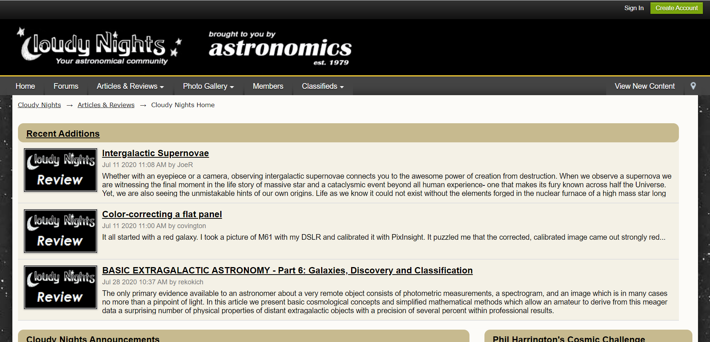
Compare your work V/s existing work
There exists a website called CLOUDY NIGHTS
Cloudy Nights is a forum which also features articles and reviews.

Slide 7
We aim to incorporate more features into our website. These include:
A provision for our users to get in contact with an exclusive Dealers (future enhancement).
Allow for users to send in their stargazing images which we will incorporate into the Gallery.
For Future Development, we can also implement a built-in service in the website to gather the user's GPS information and give accurate weather data and star chart data based on their location in the country or the planet.

Slide 8
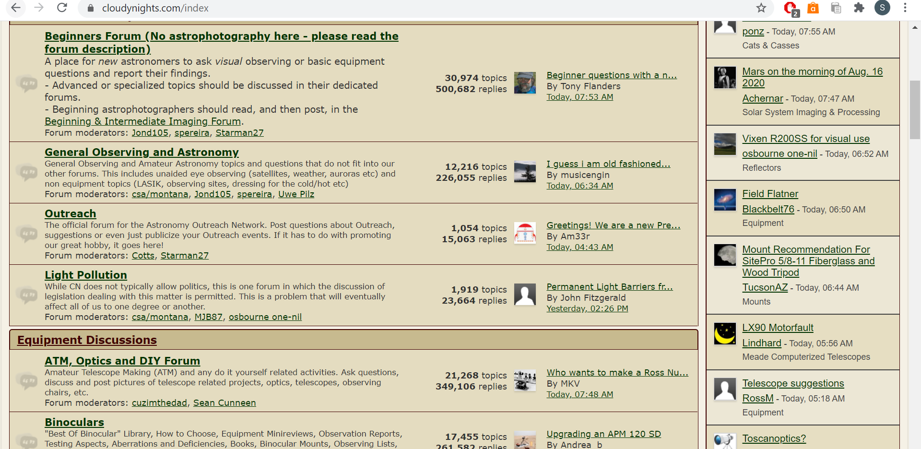
Further, our website will have a fairly modern and clean feel to it that will provide for a pleasant user experience (as the Cloudy Nights website seems monotone and slightly of putting with the tan shade overall.)

Slide 9
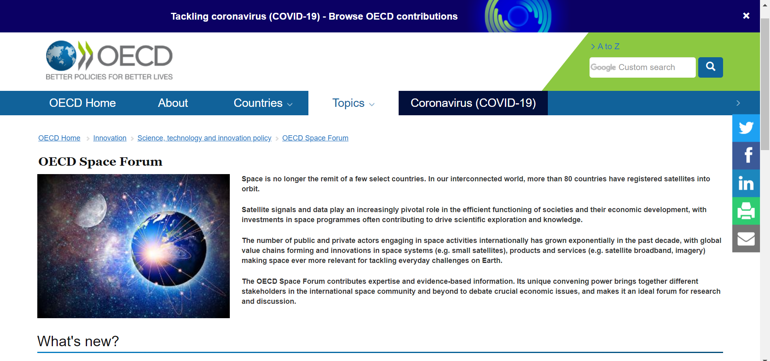
There also exists a platform called OECD Space Forum

Slide 10
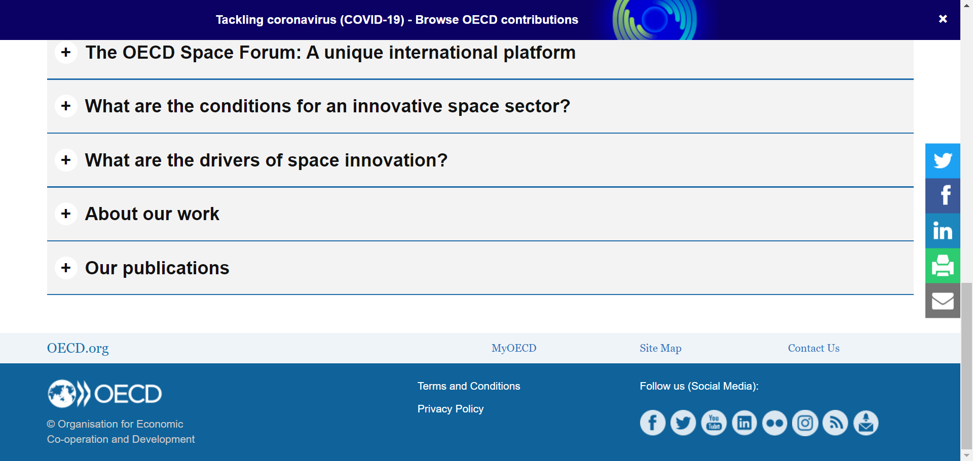
Again, OECD provides news, articles and publications; very similar to Cloudy Nights.
The addition of inclusion of links to buying trusted astronomical equipment products such as telescopes, is what sets us apart from OECD.

Slide 11
Client & End users of the system
The following are the clients or users of our system:
Space enthusiasts.
Astronomers.
Anyone interested in viewing or buying Astronomical Equipment.
Any individual keen on discussion of space-related technology or topics.
Retailers of Astronomical Equipment/ Technologies/ Softwares or Games.

Slide 12
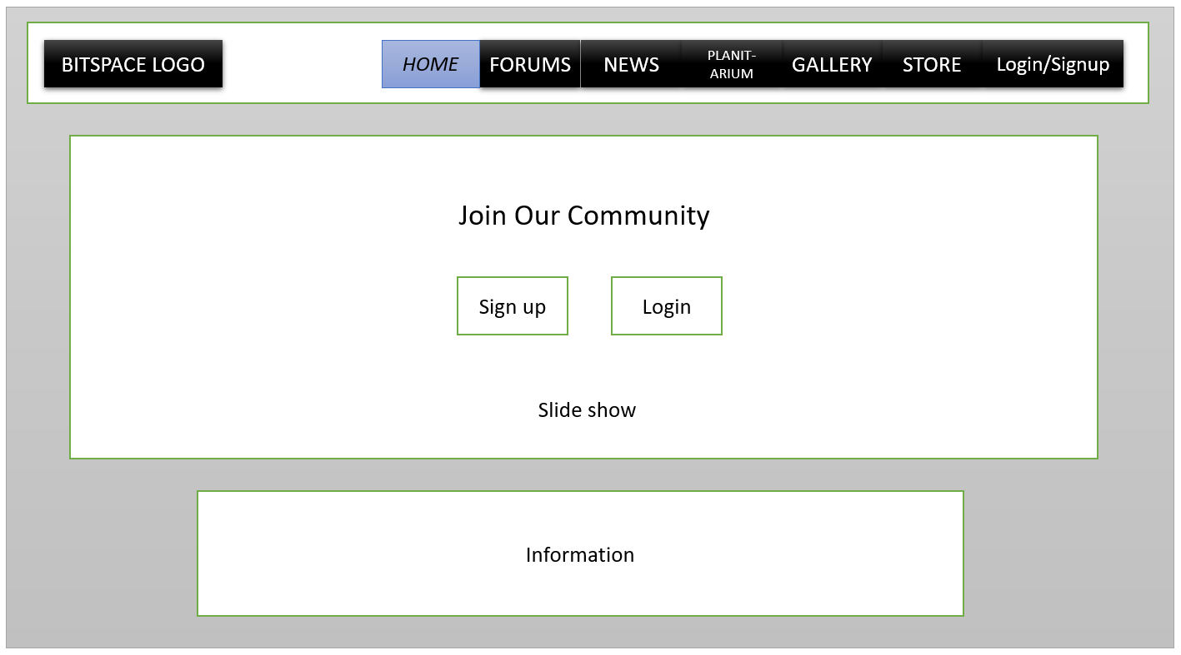
Prototype of the complete system: Landing Page

Slide 13
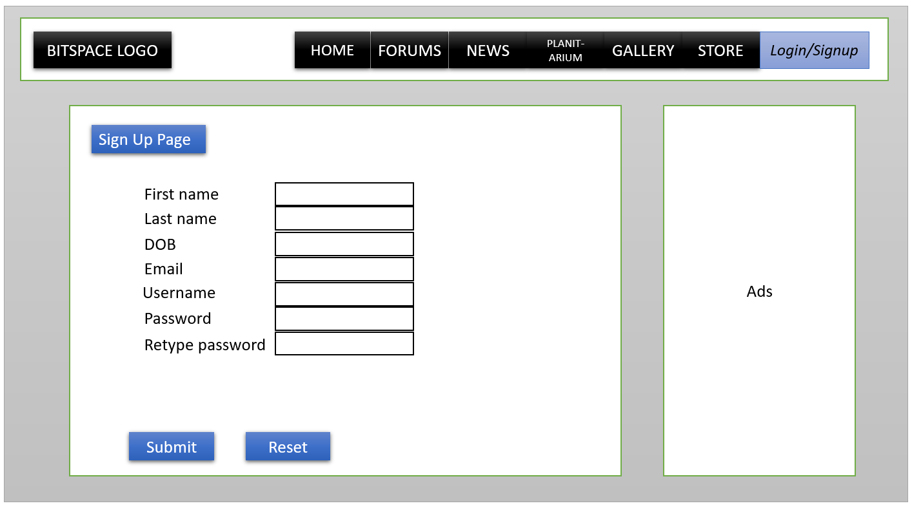

Slide 14
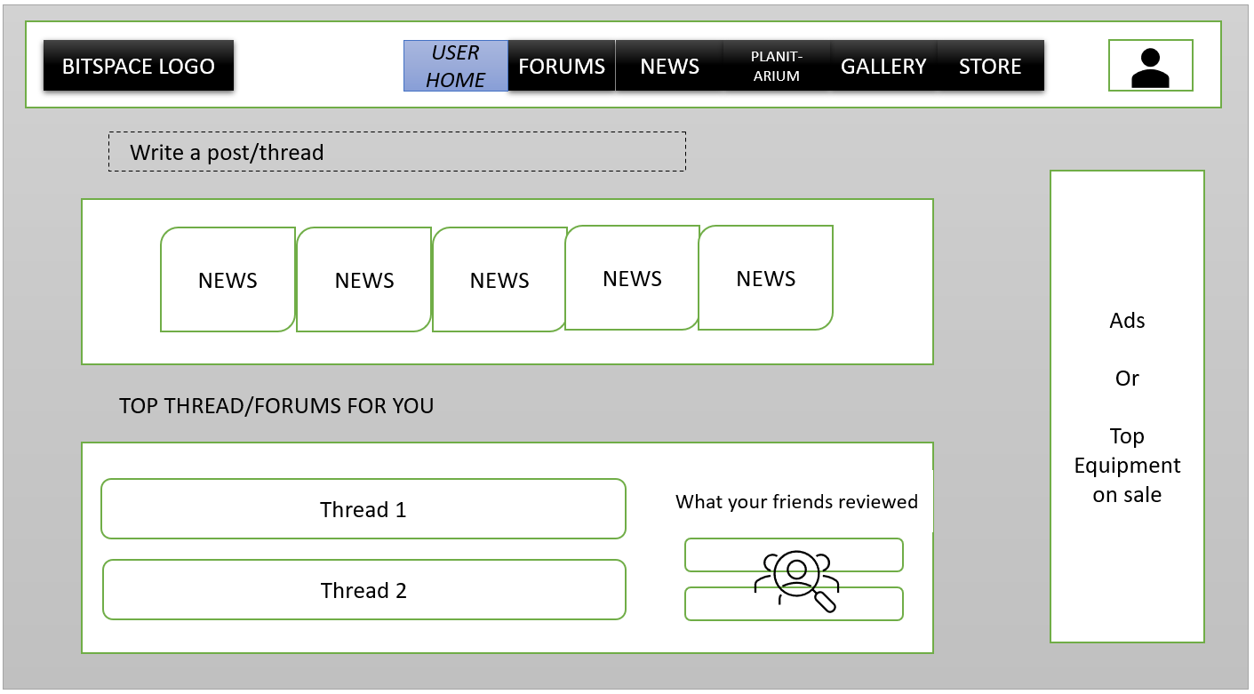

Slide 15
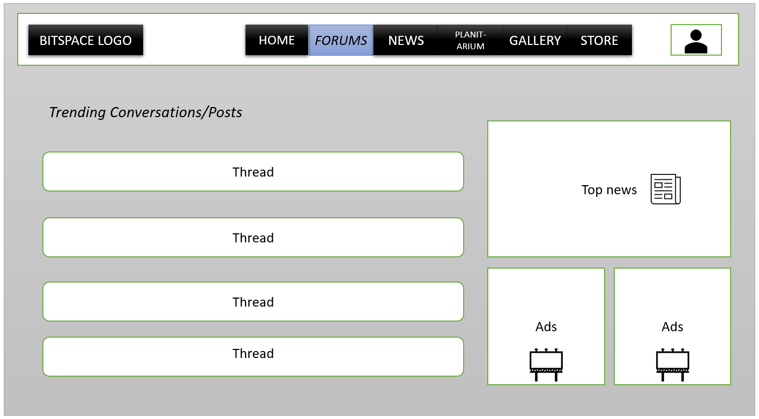

Slide 16
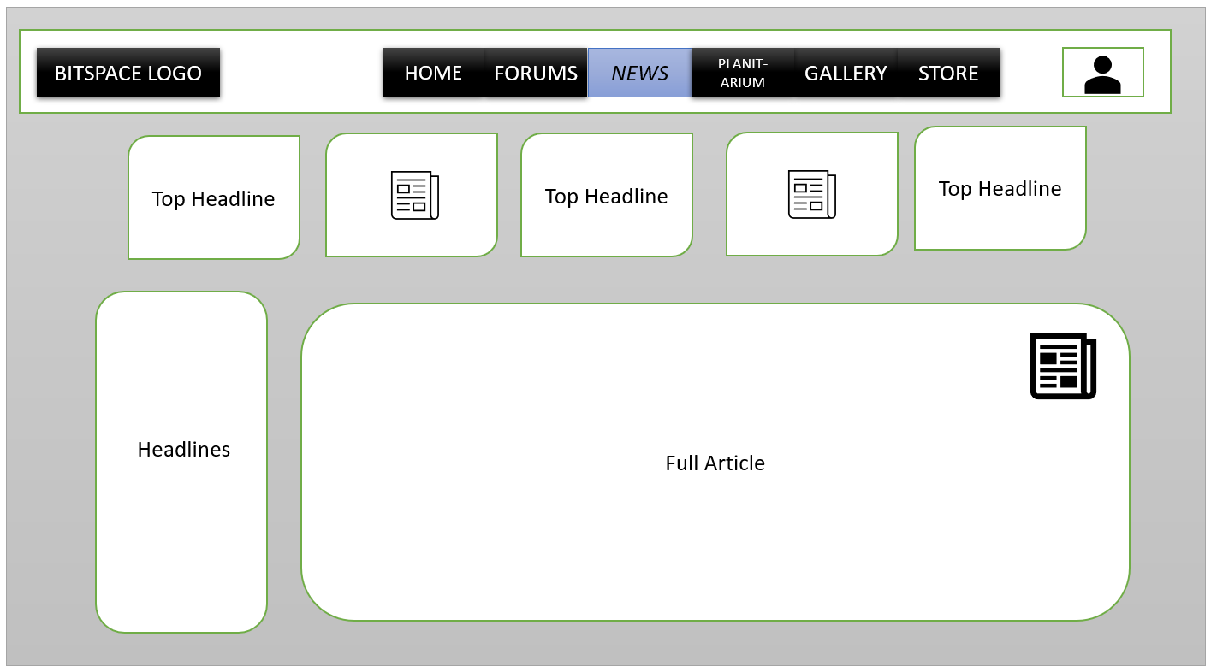

Slide 17
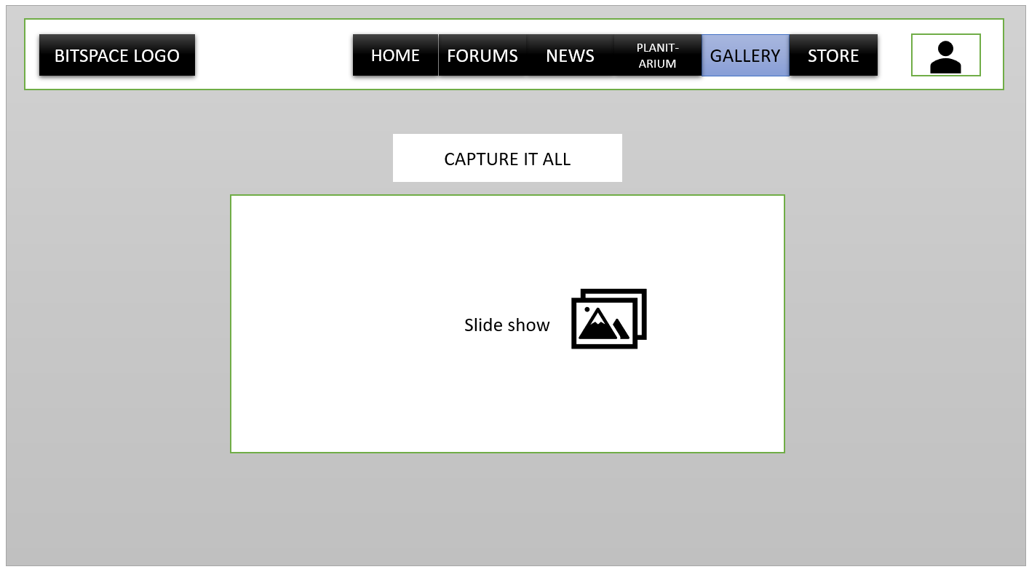

Slide 18
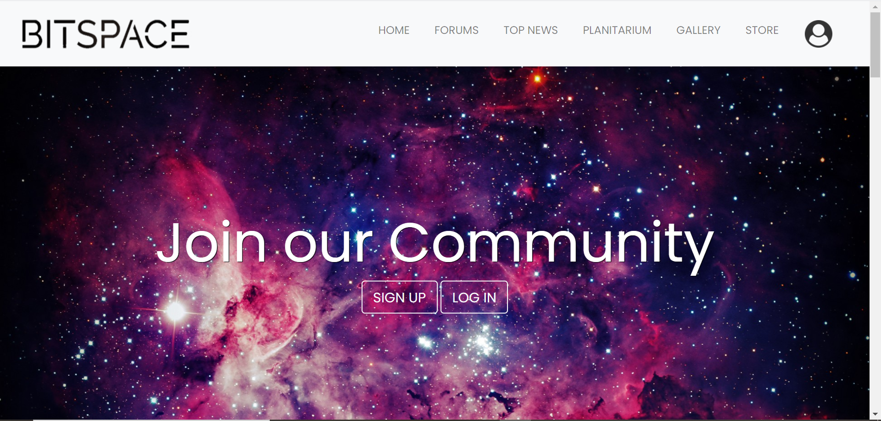
Landing page

Slide 19
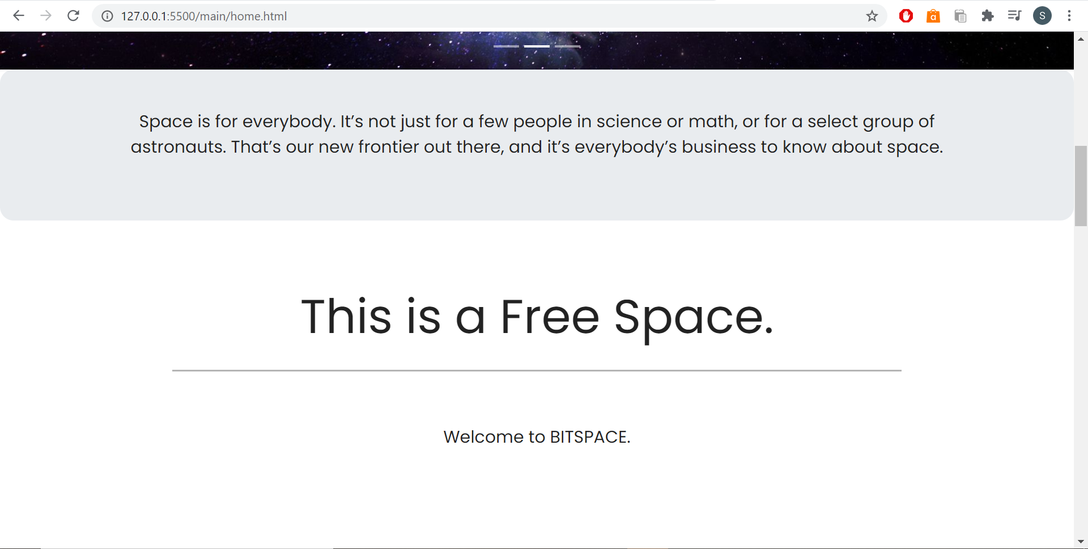

Slide 20
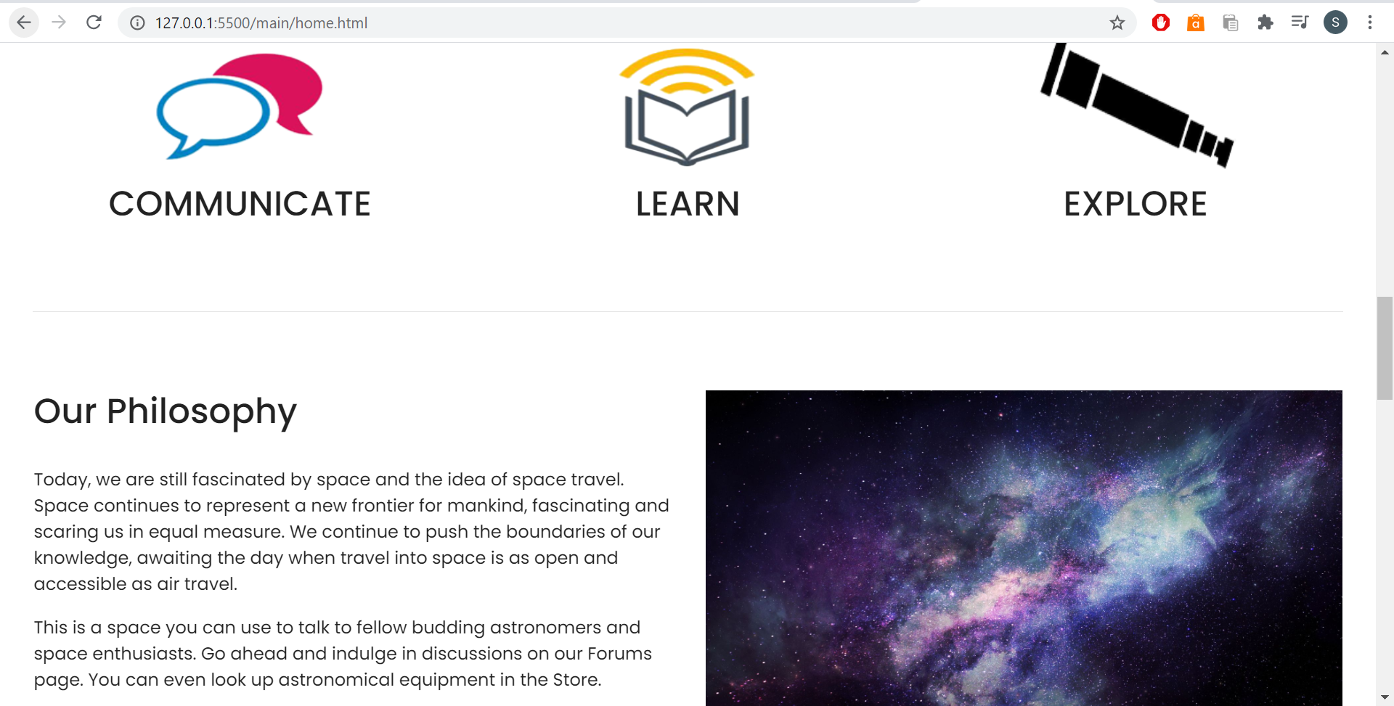

Slide 21
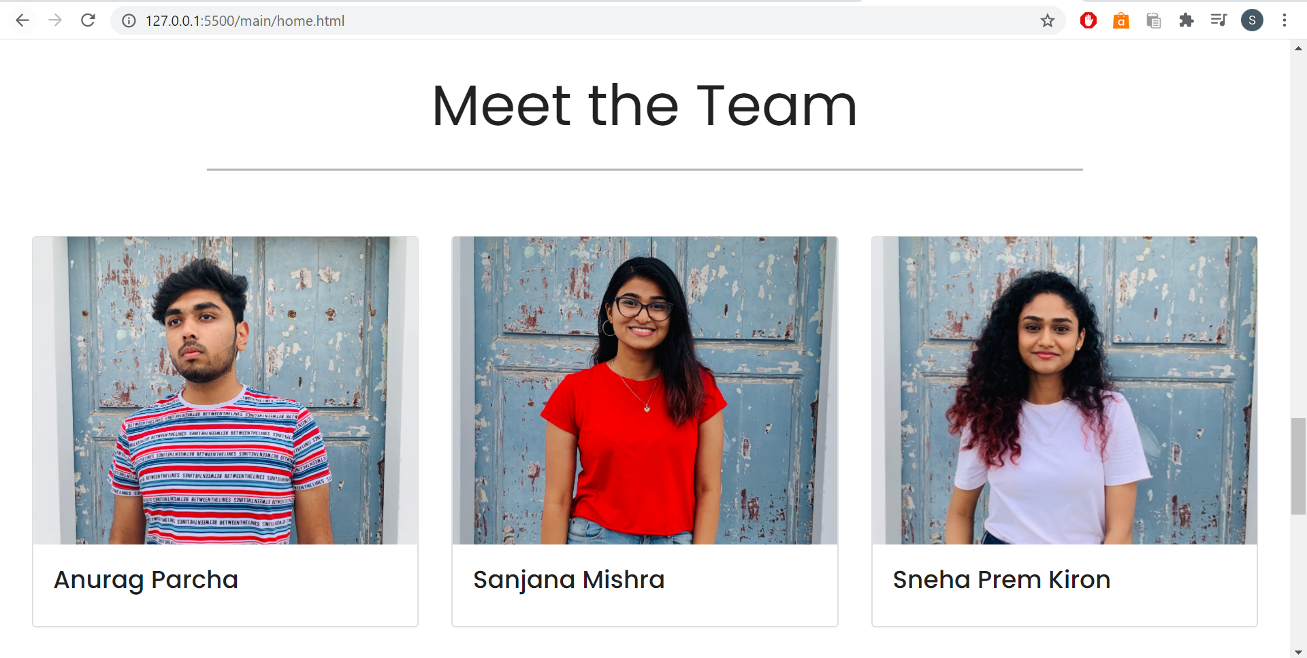

Slide 22
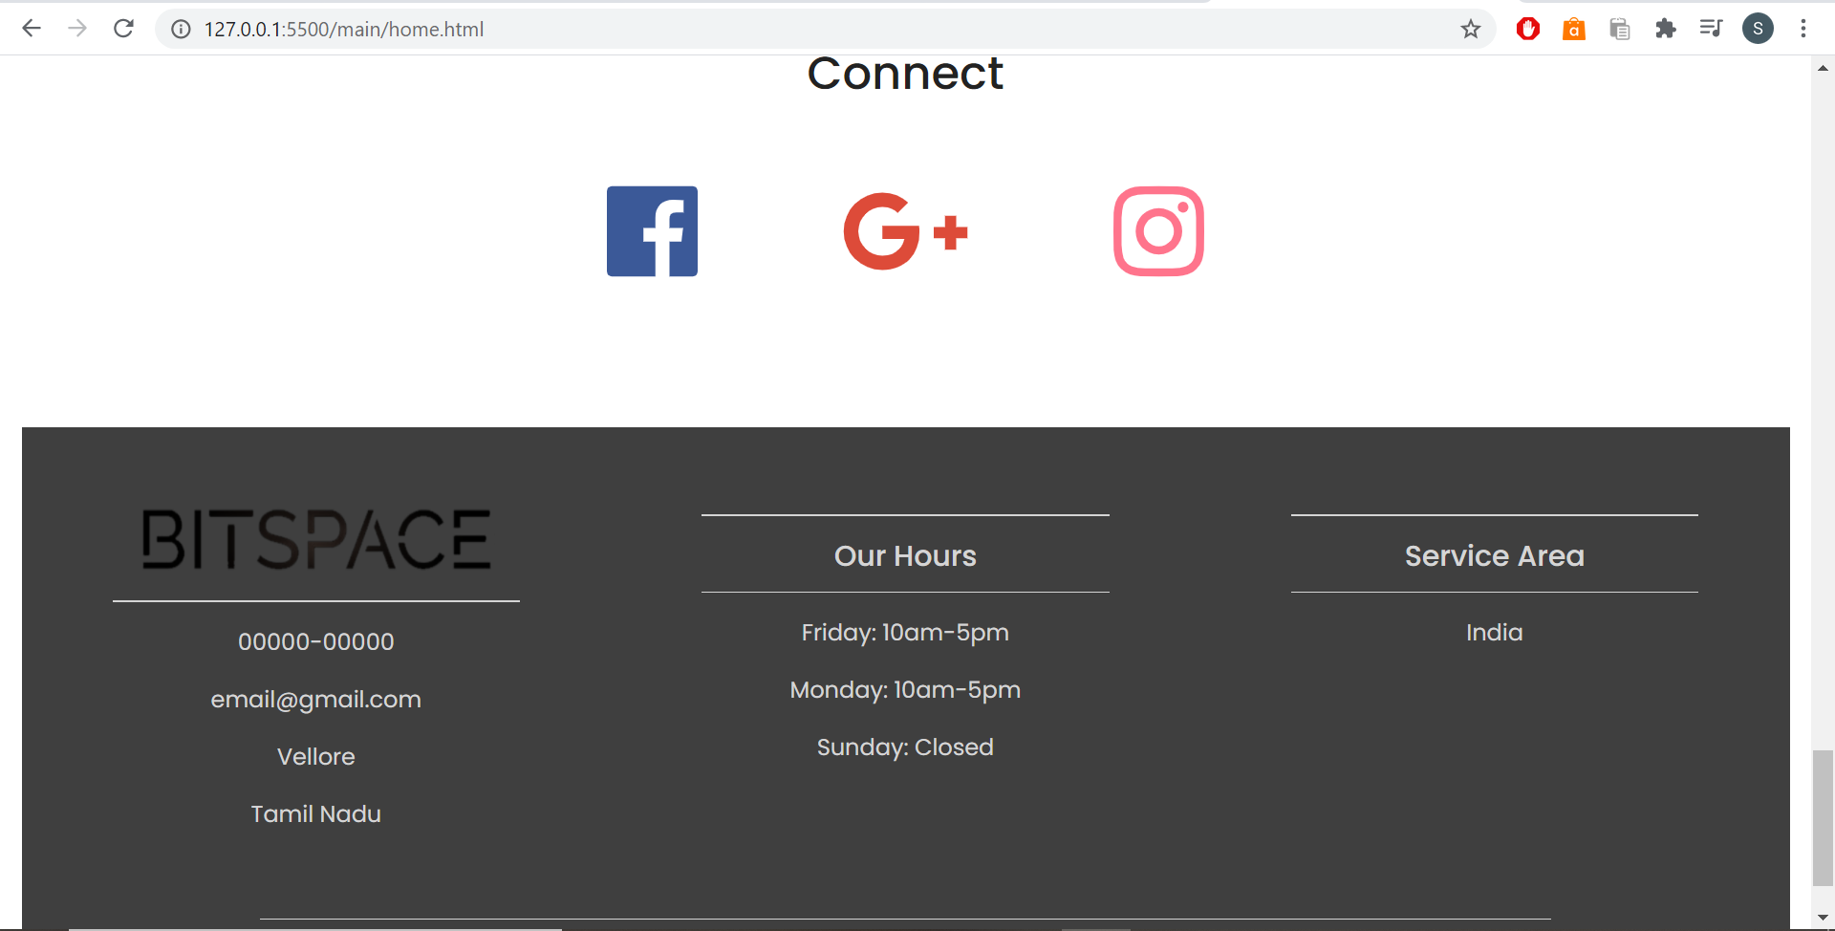

Slide 23
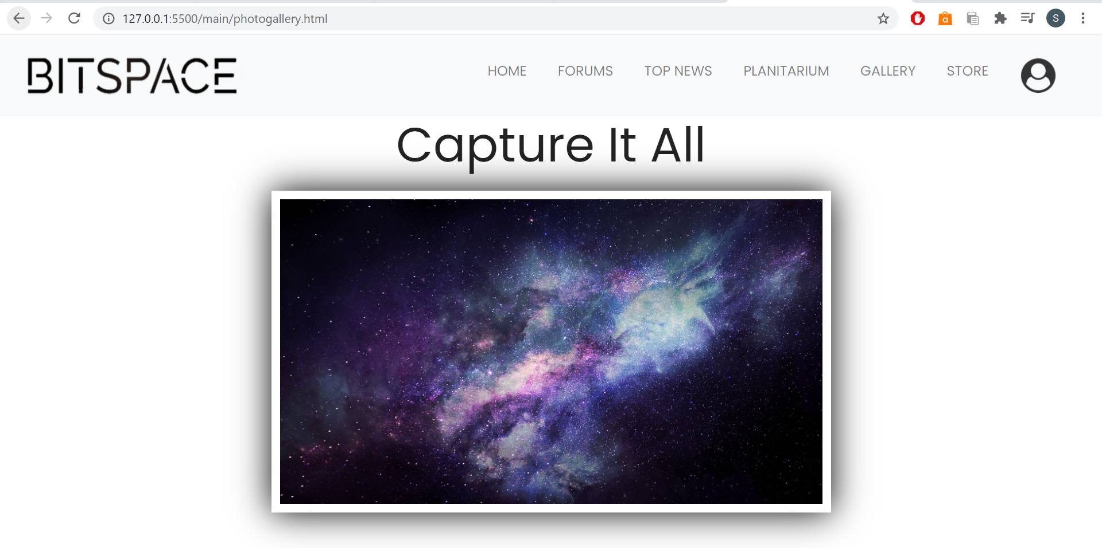
Photo gallery page

Slide 24
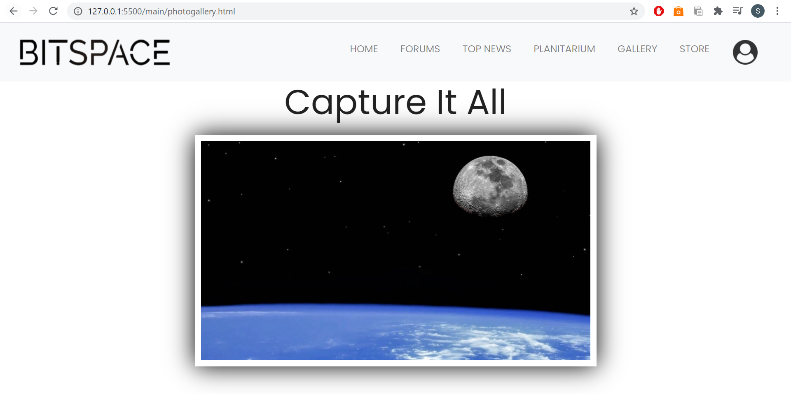

Slide 25
References
https://www.cloudynights.com/index
https://space.com/
http://www.oecd.org/innovation/inno/space-forum/
https://www.websitebuilderexpert.com/building-websites/
https://www.w3schools.com/html/

